Slide 1
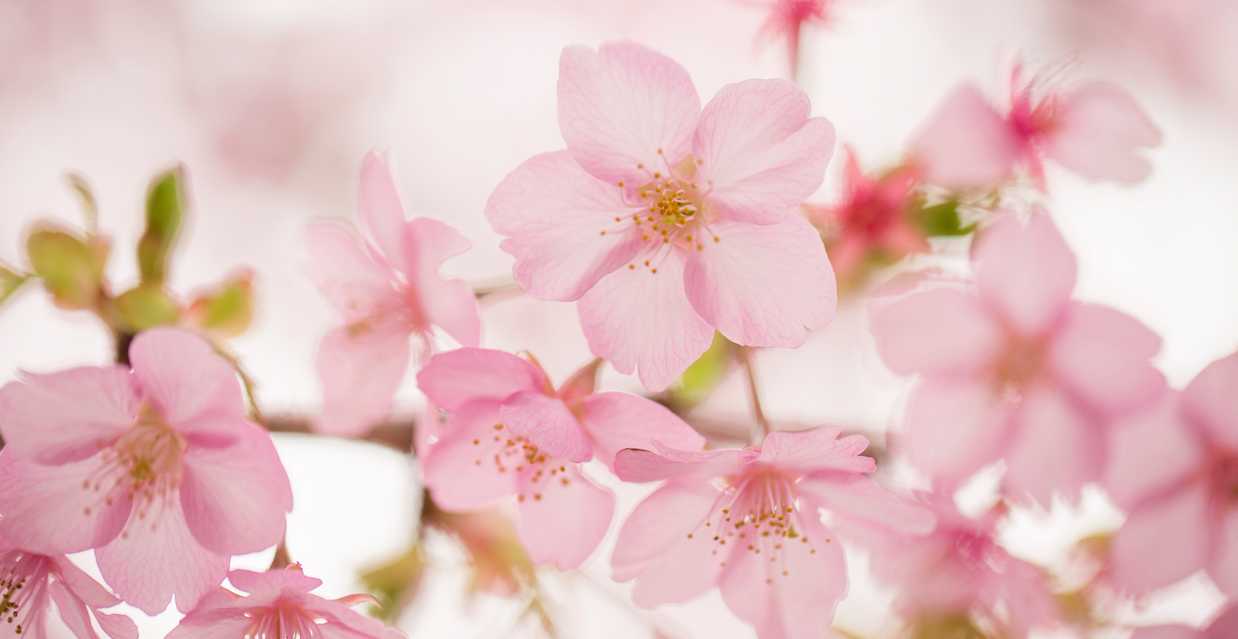
Anger Strategies
By Mikaela

Slide 2
Calm down
Thinking happy thoughts

Slide 3
Think of a pet
Look at photos

Slide 4
Do you like my PowerPoint Slides?
Thank You

